Slide 1
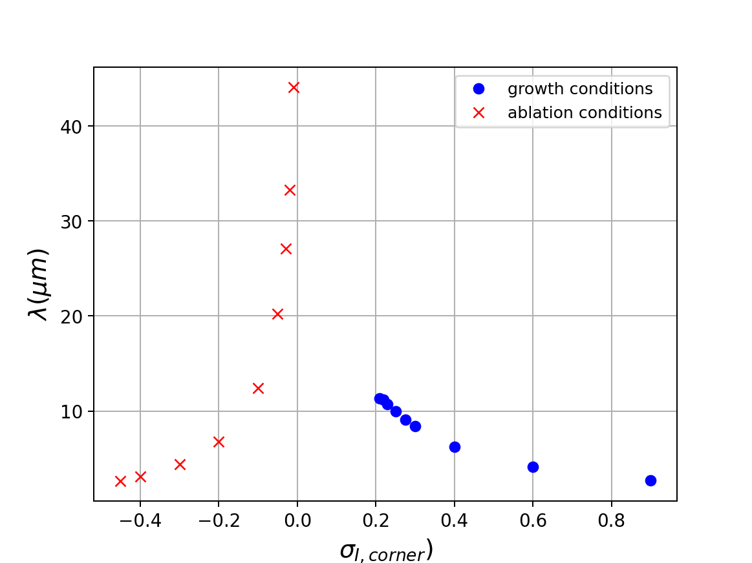
Faceted ablation yields to rounding
Faceted growth yields to dendritic growth

